Slide 1
“MASSIVE & WIDESPREAD FRAUD”?* A Compendium of Statistically Fallacies in Claims about the 2020 Presidential Election
Bernard Grofman
University of California, Irvine
Jonathan Cervas
Carnegie Mellon University
June 19, 2023
* Title based on a Truth Social post by former President Donald Trump, December 3, 2022

Slide 2

Introduction
After the 2020 presidential election, the losing candidate, Donald Trump, claimed that he had been the victim of massive voter fraud that denied him the election.
We deal solely with claims about fraud that are grounded, at least in part, on indisputable facts about statistical features of the 2020 presidential election, and comparisons of its outcomes to those of previous presidential elections.
June 17, 2023

Slide 3

Compendium of Claims about Fraud in 2020

Slide 4
Type of Claims
Affidavits
Dominion
personal affidavits alleging fraud in particular precincts
particular voting machine vendor changing votes
Videos
Dead people voting
allegedly showing direct evidence of vote tampering by poll workers
more voters voted than were on the jurisdiction’s electoral roll
Manipulation of Machines
videos showing the supposed ease of manipulating the record of votes produced by voting machines or mail ballots
June 17, 2023

Slide 5
Fraud Claims
Plausibility
Repetition
The fact that many of these claims about massive fraud in 2020 (including most of those we discuss in this essay) are plausible on their face, even though fallacious, make them harder to refute.
There is the mesmerizing power of repetition; the claim of massive fraud in 2020 is stated ad nauseam in conservative media sources and by former President Trump and his allies.
June 17, 2023

Slide 6
Reason for belief about fraud
Polarization
Traditional/Cable News/Media
level of present-day polarization, in which partisan identities shape beliefs (Iyengar et. al., 2019; Abramowitz and Webster 2018)
echoed as indisputable by a multiplicity of sources that voters trust
Social Media
Follow the Leader
siloization of communication channels along partisan and ideological lines (Prior, 2013; Robertson et. al. 2023)
public changes its policy views to match the politicians they support (Lenz 2012)

Slide 7
Agenda
01. Arithmetic fallacies
02. Improper use of stat. significance
Drawing conclusions from unweighted averages
Cherry-picking the data
Confusing percentages and percentage point changes
Relaying on comparisons between elections by looking at differences in a large number of places, i.e., counties
03. Inaccurate probabilistic reasoning
04. Syllogistic arguments
05. Syllogistic arguments
Based on cross-election statistical comparisons
Based on within-election comparisons
Underestimating the frequency of same name and birthday among voters
June 18, 2023

Slide 8
Arithmetic Fallacies

Slide 9
Cherry-picking the data.
Definition
Example
The most primitive form of failing to weigh the data properly is cherry-picking the data to emphasize only those facts that lead to the desired conclusion.
In presenting only some facts, a claimant can appear to have been honest while suppressing pertinent information that otherwise would prove their claims either false or incomplete.
Because the data being cited are accurate, cherry-picking can prove a persuasive tool.
Biden won fewer counties than Clinton
Biden did less well against Trump than did the previous Democratic candidate and, since Trump beat Clinton, absent fraud, the implicit (and often explicit) conclusion is Trump must also have beaten Biden in terms of overall total vote nationally
Racial minority support for Biden was (marginally) lower than for Hillary Clinton, and Trump did better among rural voters in 2020 than he did in 2016

Slide 10
Failing to weight units.
Definition
Example
Failing to recognize that large changes in one direction in small population subsets or small population demographic subgroups can be compensated for by small changes in the other direction in large population subsets or demographic units
It was observed that Trump won more counties in 2020 than he did in 2016, with the implication being that he must have done better in 2020 than in 2016 (Swenson, 2021).
But this ignores the number of people in each county

Slide 11
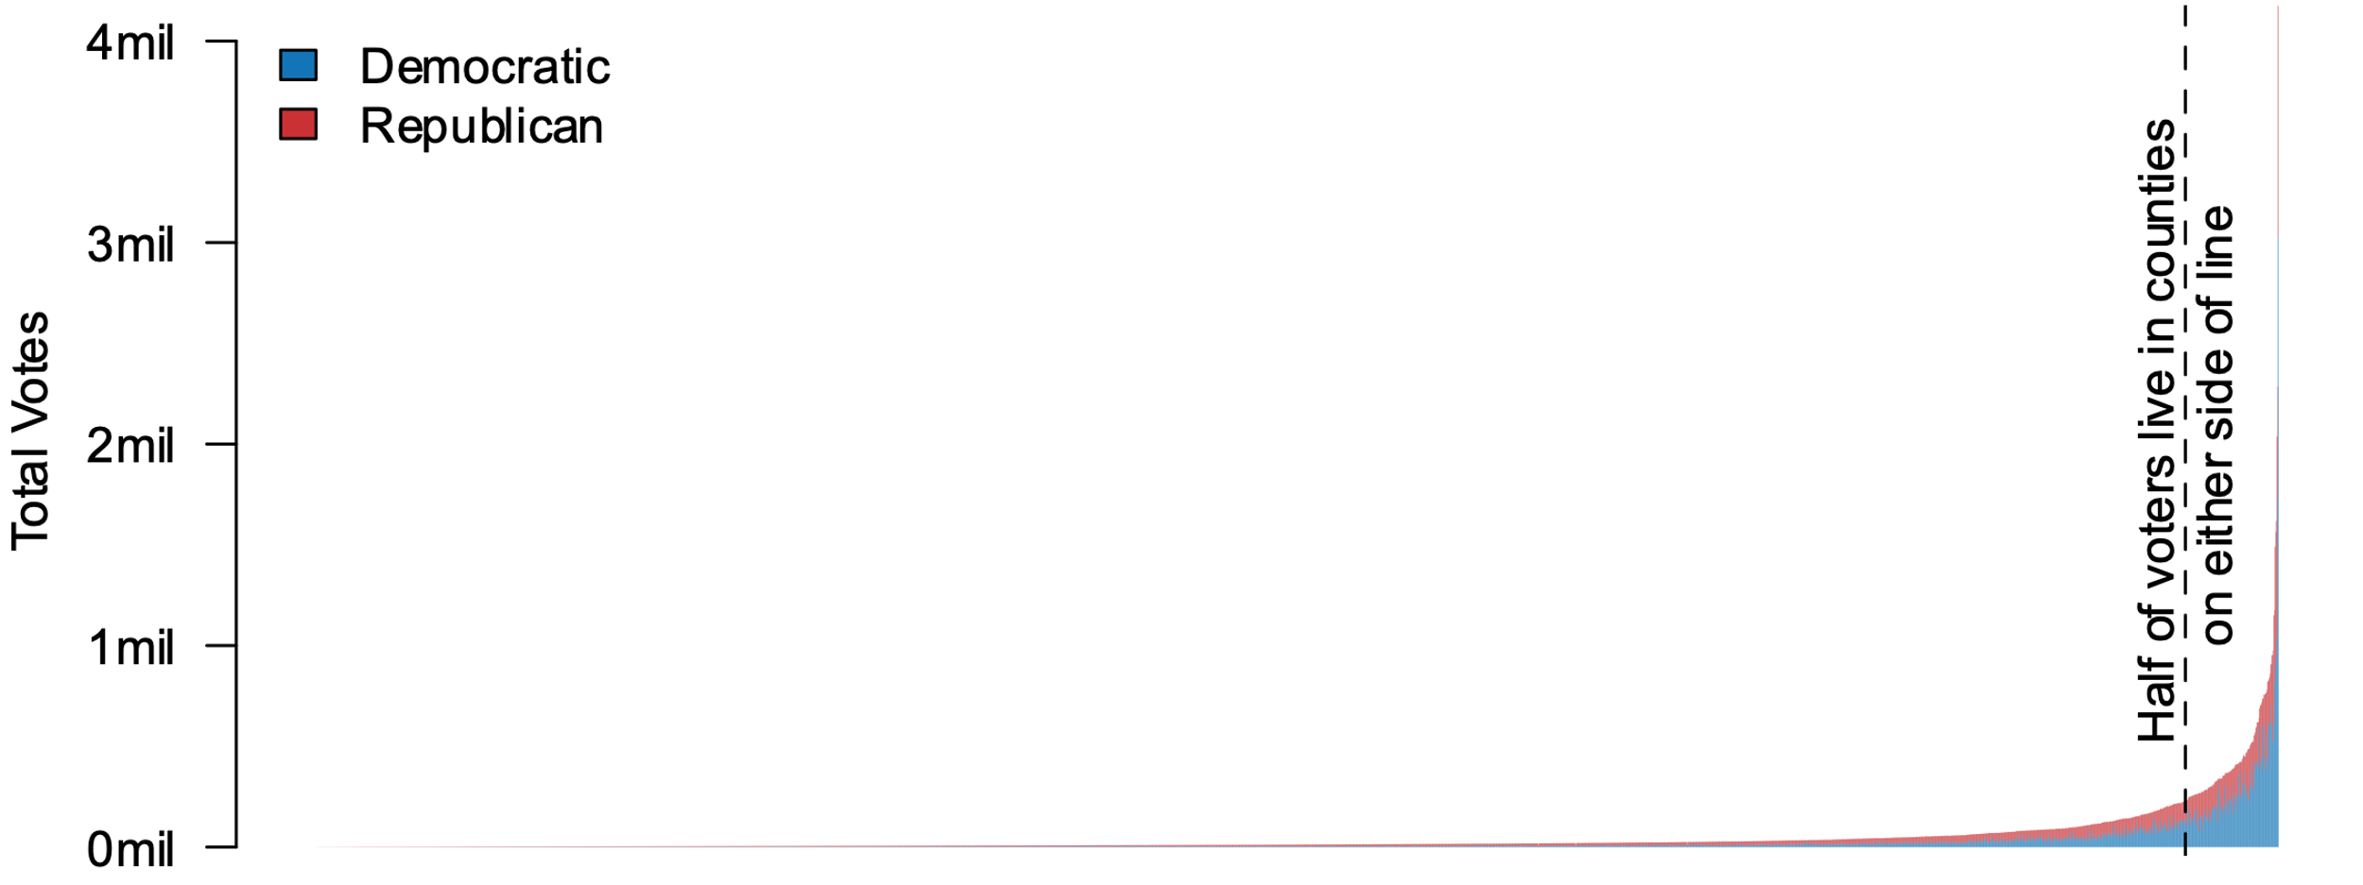
Voters in Each county
Note: One bar per county. Most counties have very few voters (long tail on the left of the plot). Among small and modestly populated counties, Trump won a majority in most; among those with the largest populations, Biden won a majority. Even in the largest counties, there are plenty of Trump voters, and in the smallest counties, there are some Biden voters.

Slide 12
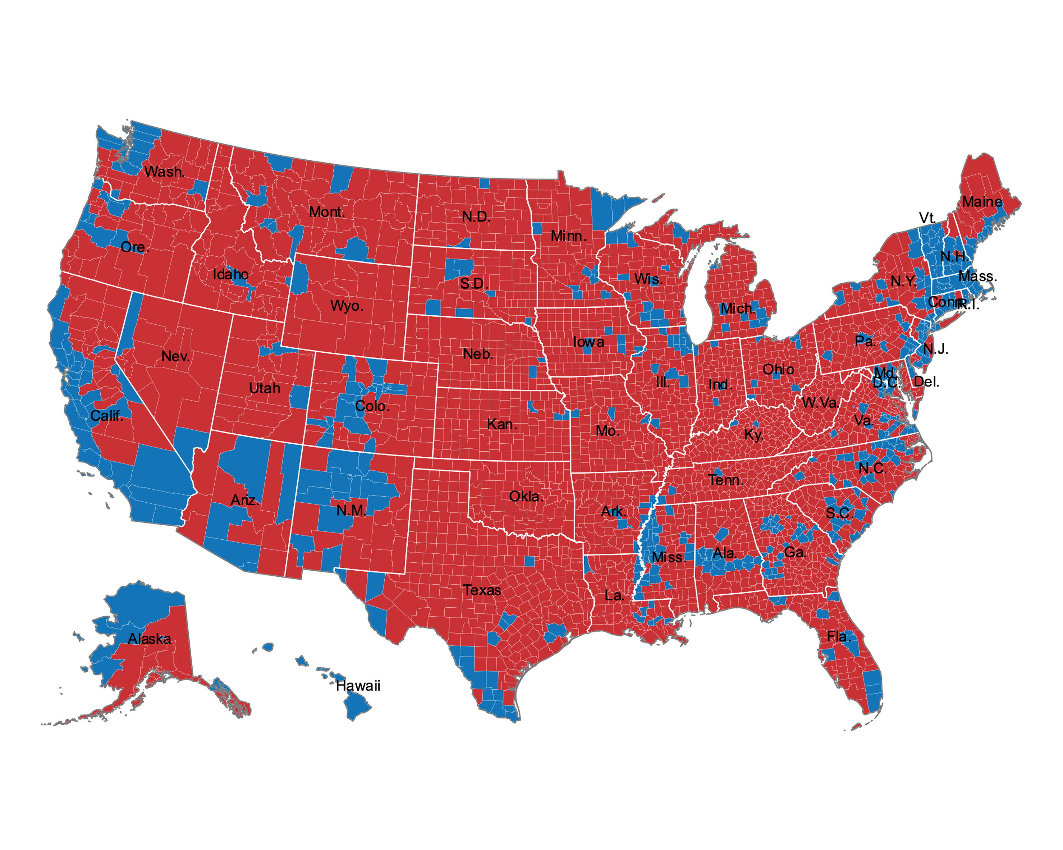
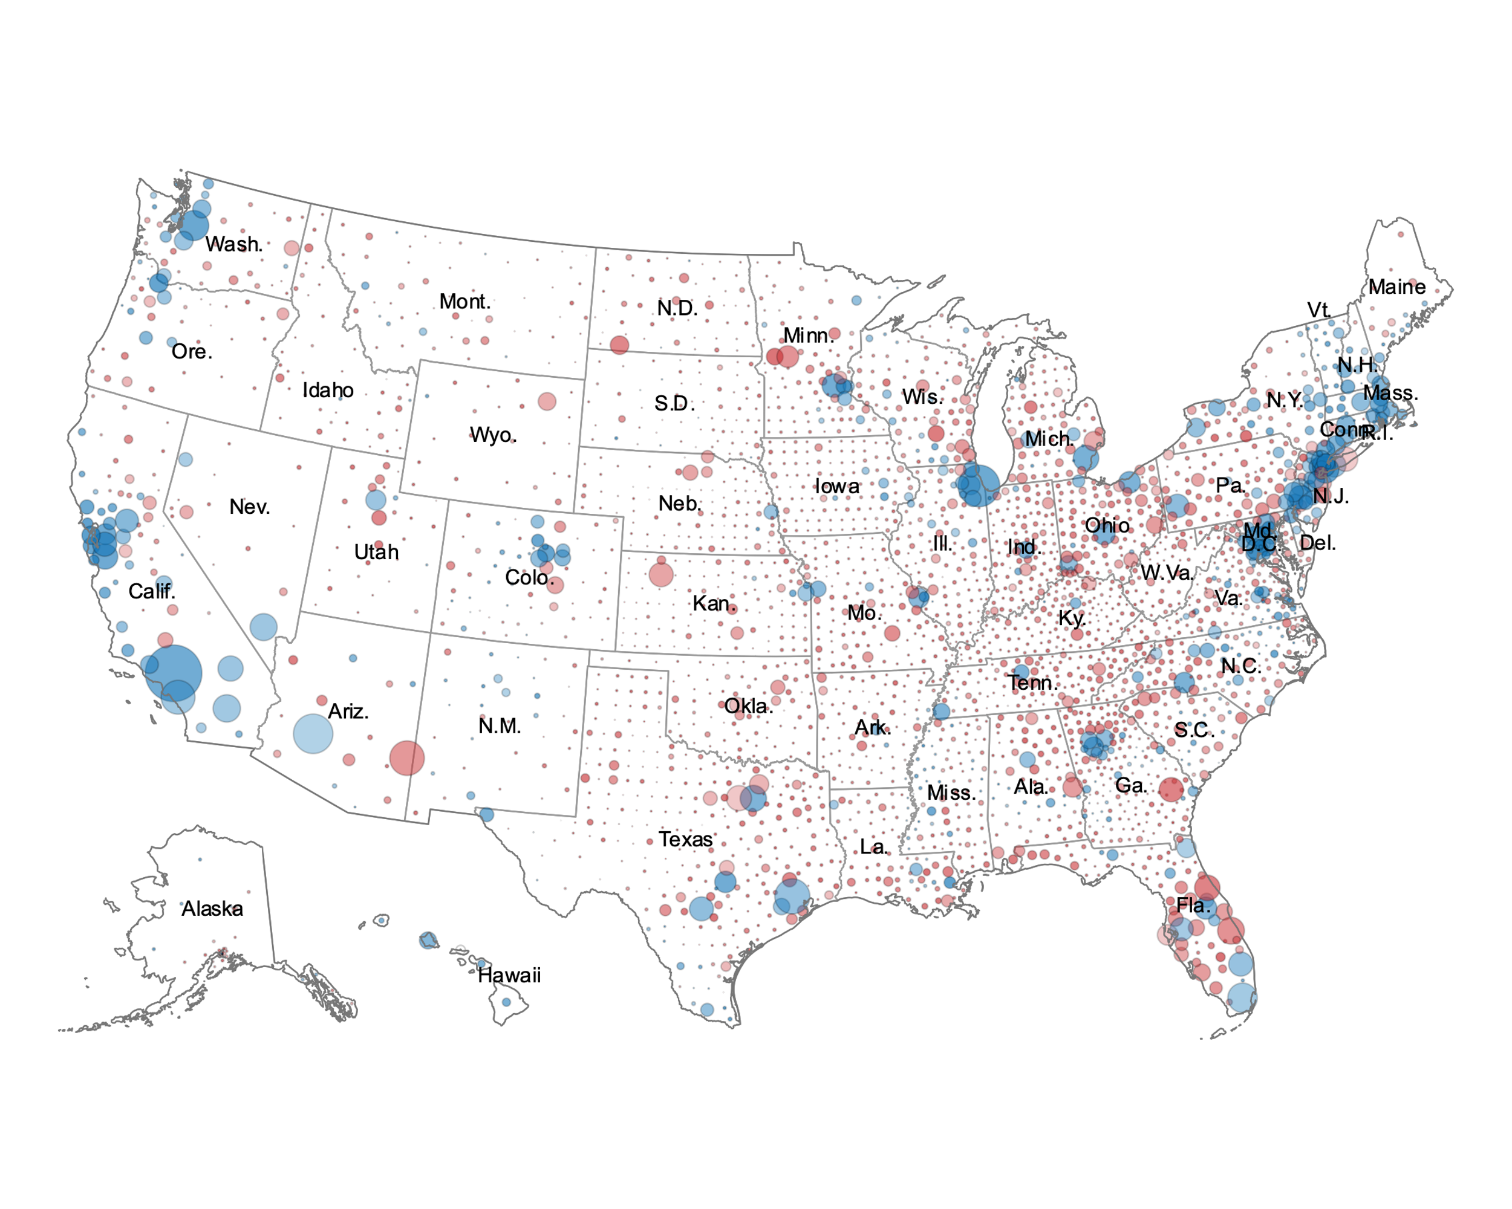
Geographic ‘weighting’
2020 Choropleth, by county
2020 Bubble, by county

Slide 13
Exit Polls
One crucial factor that contributed to Biden's victory over Trump was the composition of the electorate. In 2020, both the raw number (+11.5 million) and proportion (+3 percentage points) of minority voters increased compared to 2016. Trump's support increased among all demographic subgroups in 2020, including Whites.
At first glance, these facts might suggest that Biden performed worse than Clinton in terms of the popular vote share in 2016.
2016 | White | Black | Latino | Asian | Other racial/ethnic groups
 | 70% | 12% | 11% | 4% | 3%
Clinton | 37% | 89% | 66% | 65% | 56%
Trump | 57% | 8% | 28% | 27% | 36%
2020 | White | Black | Latino | Asian | Other racial/ethnic groups
 | 67% | 13% | 13% | 4% | 4%
Biden | 41% | 87% | 65% | 61% | 55%
Trump | 58% | 12% | 32% | 34% | 41%
However, to understand what happened, we need to examine changes in each group's share of the electorate, which depends on changes in the size of voting populations and changes in voting preferences within those populations.

Slide 14
Exit Polls
One crucial factor that contributed to Biden's victory over Trump was the composition of the electorate. In 2020, both the raw number (+11.5 million) and proportion (+3 percentage points) of minority voters increased compared to 2016. Trump's support increased among all demographic subgroups in 2020, including Whites.
At first glance, these facts might suggest that Biden performed worse than Clinton in terms of the popular vote share in 2016.
2016 | White | Black | Latino | Asian | Other racial/ethnic groups
 | 70% | 12% | 11% | 4% | 3%
Clinton | 37% | 89% | 66% | 65% | 56%
Trump | 57% | 8% | 28% | 27% | 36%
2020 | White | Black | Latino | Asian | Other racial/ethnic groups
 | 67% | 13% | 13% | 4% | 4%
Biden | 41% | 87% | 65% | 61% | 55%
Trump | 58% | 12% | 32% | 34% | 41%
However, to understand what happened, we need to examine changes in each group's share of the electorate, which depends on changes in the size of voting populations and changes in voting preferences within those populations.

Slide 15
Exit Polls
One crucial factor that contributed to Biden's victory over Trump was the composition of the electorate. In 2020, both the raw number (+11.5 million) and proportion (+3 percentage points) of minority voters increased compared to 2016. Trump's support increased among all demographic subgroups in 2020, including Whites.
At first glance, these facts might suggest that Biden performed worse than Clinton in terms of the popular vote share in 2016.
2016 | White | Black | Latino | Asian | Other racial/ethnic groups
 | 70% | 12% | 11% | 4% | 3%
Clinton | 37% | 89% | 66% | 65% | 56%
Trump | 57% | 8% | 28% | 27% | 36%
2020 | White | Black | Latino | Asian | Other racial/ethnic groups
 | 67% | 13% | 13% | 4% | 4%
Biden | 41% | 87% | 65% | 61% | 55%
Trump | 58% | 12% | 32% | 34% | 41%
However, to understand what happened, we need to examine changes in each group's share of the electorate, which depends on changes in the size of voting populations and changes in voting preferences within those populations.

Slide 16
Difference between 2016 and 2020 (percentage point)
 | Non-Hispanic White | Black | Hispanic
Clinton/Biden | +4-points | -2-points | -1-point
Trump | +1-point | +4-points | +7-points
Note: Exit Polls conducted by Edison Research for the National Election Pool.

Slide 17
Difference between 2016 and 2020 (voters added)
 | Non-Hispanic White | Black | Hispanic | Total
Clinton/Biden | +8,123,287 (+4pt) | +3,322,117 (-2pt) | +3,465,117 (-1pt) | +15,429,985
Trump | +7,034,729 (+1pt) | +1,159,478 (+4pt) | +2,381,260 (+7pt) | +11,239,150
Note: Exit Polls conducted by Edison Research for the National Election Pool.

Slide 18
Misinterpreting Statistical Significance

Slide 19
Misinterpreting Statistical Significance
Null Hypothesis
Sample Sizes
Substantive Importance
Statistical significance can only be interpreted in the context of the specific null hypothesis being tested
P-values are very strongly linked to sample sizes
Confusing statistical significance with substantive importance

Slide 20
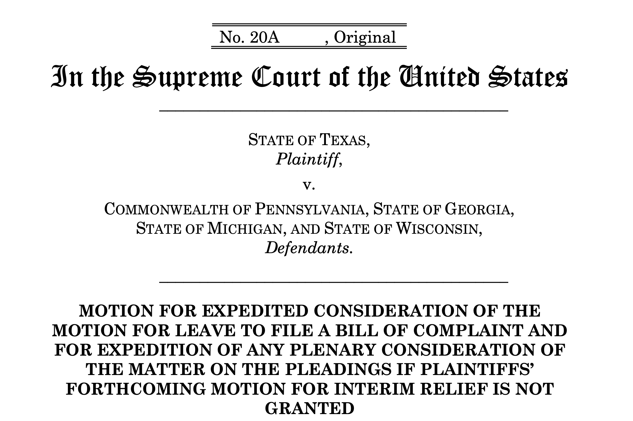
Lawsuit
Texas v. Pennsylvania, 592 U.S. ___, was a lawsuit filed at the United States Supreme Court contesting the administration of the 2020 presidential election in certain states, in which Joe Biden defeated incumbent Donald Trump

Slide 21
Hypothesis I
Dr. Cicchetti noted that he could demonstrate beyond any possibility of error that the vote share distribution for Joe Biden in 2020 differed from that of Hillary Clinton to a statistically improbable degree.
He is certainly right about that fact.
But what that shows about election fraud is — exactly nothing!
With a large enough sample size, such comparisons are virtually certain to generate statistically significant differences

Slide 22
Hypothesis II
President Trump’s share of the vote declined relative to those first reported as polls closed on election night as more ballots were tabulated, while in other states he found the reverse pattern.
Hypothesis: “the votes tabulated in the two time periods [were from] random samples from the same population of all votes cast.” (Cicchetti Declaration, page 4).
For those familiar with elections, it shows a pattern that was predicted in advance (Foley & Stewart III, 2020)

Slide 23
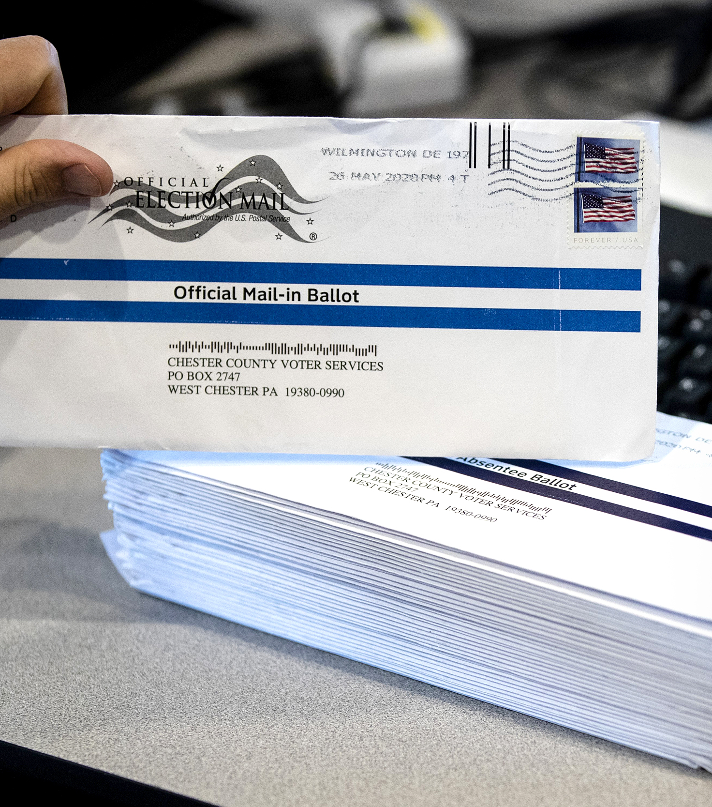
Counting Votes
Thirty-seven states allow election officials to begin processing mail-in ballots as they arrive prior to election day.
Another ten states allow processing to begin on election day, but prior to polls closing.
Only Maryland does not permit counting mail-in ballots until after polls close.
Battleground states Michigan, Wisconsin, and Pennsylvania are among the ten states that do not allow counting mail-in ballots until election day.

Slide 24
Meretricious Probabilistic Reasoning

Slide 25
Meretricious Probabilistic Reasoning
Benford’s Law
Tip of the iceberg fallacy
Benford’s Law implies that the mean value of the second digit of a distribution of votes at the precinct or other unit-level should equal 4.187
To infer from the indubitable fact of some electoral wrongdoing in most states that electoral fraud is massive in both magnitude and geographic spread
95% Probability
Same Name and Date and Year of Birth
Straw man fallacy
instances where individuals with the same name and same birthday and/or same birth year were found on voter rolls have been taken as evidence of fraud
The claim that there was no massive fraud can be rhetorically equated to the claim that there was no fraud, and the latter claim rebutted as a straw man
50% Probability

Slide 26
Logically Invalid Arguments with a True Premise involving Historical Election Results Comparisons

Slide 27
Logically Invalid Arguments with a True Premise involving Historical Election Results Comparisons
Spoiled ballots
affirming the consequent
There is an empirically accurate observation that the spoiled ballot rate of mail-in ballots in 2020 was much lower (in some states remarkably lower) than in 2016
If there is ballot fraud involving mail-in ballots (A),
then the spoilage rate among mail-in ballots will be lower than in the past (B).
The spoilage rate among mail-in ballots was lower than in the past. (B)
Therefore, there was ballot fraud involving mail-in ballots (A).

Slide 28
Logically Valid Arguments with a False Premise involving Historical Election Results Comparisons

Slide 29
Logically Valid Arguments with a False Premise involving Historical Election Results Comparisons
Presidential coattails
denying the consequent
Winning presidential candidates have coattails that aid members of their party in the House of Representatives to gain seats
The Democrats lost 13 seats in the House of Representatives in 2020, which violates this expectation, and so the claim goes that the implication is that there must have been massive multi-state fraud
If a presidential candidate wins election (A),
then there will be a gain in the number of members of his party in the U.S. House of Representative (B).
There was no gain for the Democrats in the House in 2020 (not B)
Therefore, Biden must have lost the election (not A)
Negative coattails are more likely when:
elections are close in popular vote
there is substantial partisan bias against the party of the presidential winner in the House
a substantial portion of the votes for the winning presidential candidate are wasted in states that are won by large margins,
the winning president’s party picked up a significant number of seats in the previous midterm election. All four of these features are found in 2020.

Slide 30
Logically Valid Arguments with a False Premise involving Historical Election Results Comparisons
Bellwether counties
denying the consequent
Biden lost most of the counties that had been bellwether counties, and therefore since bellwether counties predict presidential elections, Biden must really have lost the election
If a presidential candidate wins the election (A)
then they can be expected to carry almost all the bellwether counties (B),
Biden lost almost all the bellwether counties (not B)
Therefore, Biden must have lost the election (not A)
A simple binomial model shows that by chance alone, in large groups, some individuals can appear to have repeated (predictive) success even though, for any given event, the probability of success of any actor is only 0.5.
By showing that as partisan polarization increases, and presidential politics nationally is competitive, the Electoral College sometimes have Democrats winning and sometimes Republican winning (three each in the 21st century), the likelihood of bellwethers declines

Slide 31
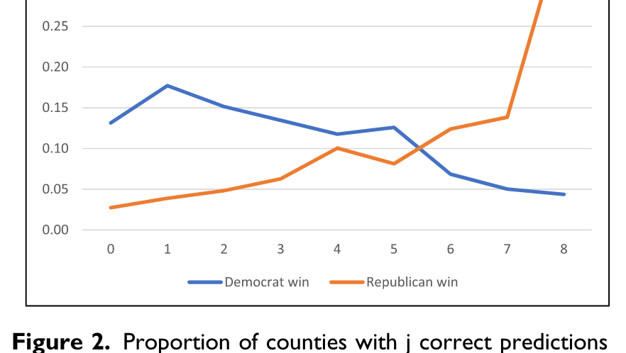
Bellweathers
Grofman and Chen (2022)
Grofman, Bernard, and Haotian Chen. 2022. “Understanding the Factors that Affect the Incidence of Bellwether Counties: A Conditional Probability Model.” Political Research Quarterly: 106591292110576.
the number of bellwethers we now find is (a) lower than we would expect from the “tossing a fair coin” model of Table 1 and (b) has been exhibiting a steady downward trend
“Ceteris paribus, the higher the negative correlation between predictive success when the winner is a Democrat and predictive success when the winner is a Republican, the lower will be the likelihood of there being bellwether counties.” (Grofman and Chen 2022)

Slide 32
Logically Valid Arguments with False Statistical Premises Using Comparisons Based on Features or Components of the Same Presidential Election

Slide 33
Logically Valid Arguments with False Statistical Premises Using Comparisons Based on Features or Components of the Same Presidential Election
Matching design (within-election, split ticket voting versus straight ticket voting)
Ayyadurai’s Trump plot and equivalent Biden plot
Ayyadurai’s Straight Ticket v. Split Ticket vote: that support levels in straight ticket votes and split ticket votes should be unrelated to Trump’s share in a precinct unless there is voter fraud
It turns out there is an easy explanation for this, and it is not fraud, but instead conditional probability.
In a heavily Republican precinct, split-ticket voters are likely to be those voting against Trump (and since Trump ran well among Republicans in heavily Republican precincts, there won’t be many of them); this contrasts with heavily Democratic precincts where split-ticket voters are likely to be ones voting for Trump

Slide 34
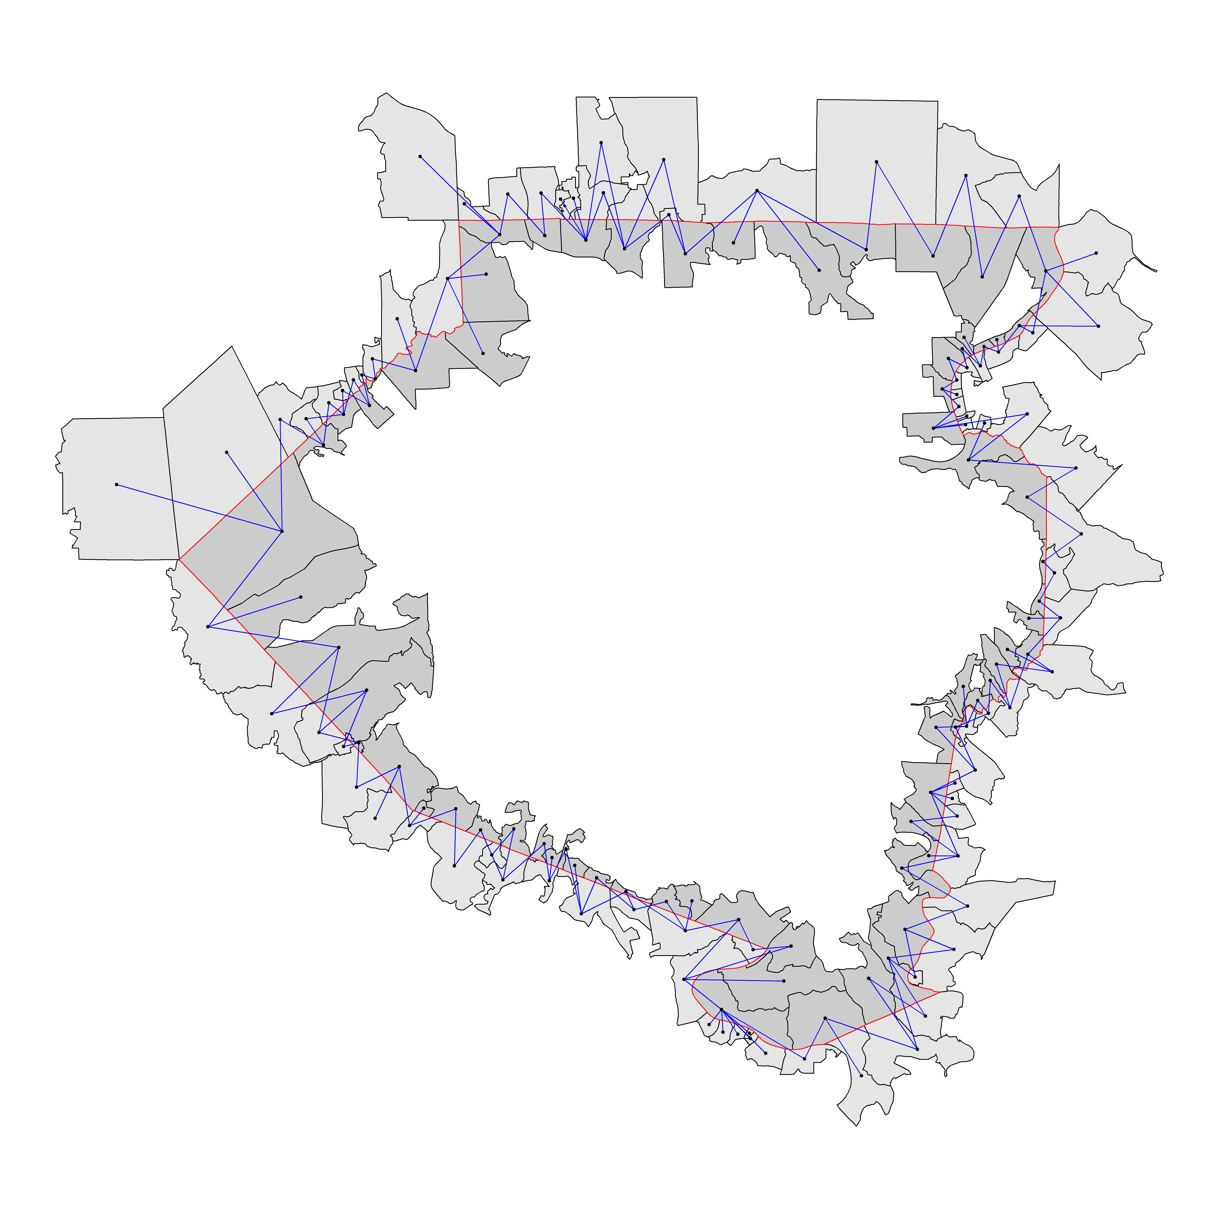
Matching design (within-election comparisons of areas with and without fraud claims)
Butler County, PA
Beaver County, PA
Lott (2020) uses an apparently sophisticated attempt to prove election fraud via statistical analysis, which is now forthcoming in a peer-reviewed journal (Lott, n.d.)
“[S]tatistical evidence that irregularities in the absentee vote counting procedure in Fulton County and Allegheny County suppressed votes for Trump and bolstered Biden’s vote count.” (Eggers et al 2021)
A matched pairs analysis which compares the difference in support for Trump in adjacent precincts in counties in Georgia and counties in Pennsylvania, such that one of each pair is in a county which voted for Biden and one is in a county which voted for Trump
Allegheny County, PA
Westmoreland
County, PA
Washington County, PA
Lott’s paper does not show how precincts are matched. He says” comparisons across the political boundaries had to be done by hand. We disagree, and show that the process can be automated in the figure above.

Slide 35
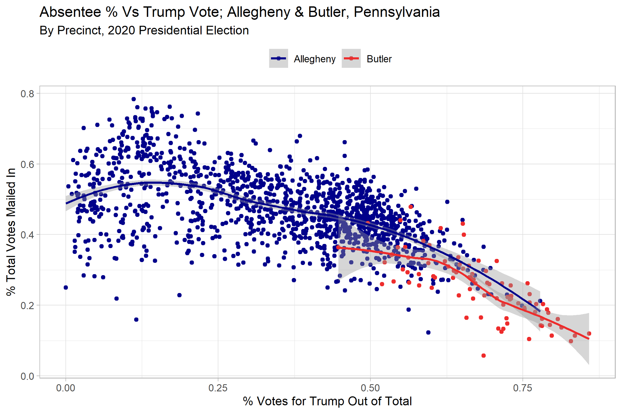
Trump mail-in vote by level of total support
Note: Each dot is one precinct. There are many more precincts in Allegheny County than Butler County.

Slide 36
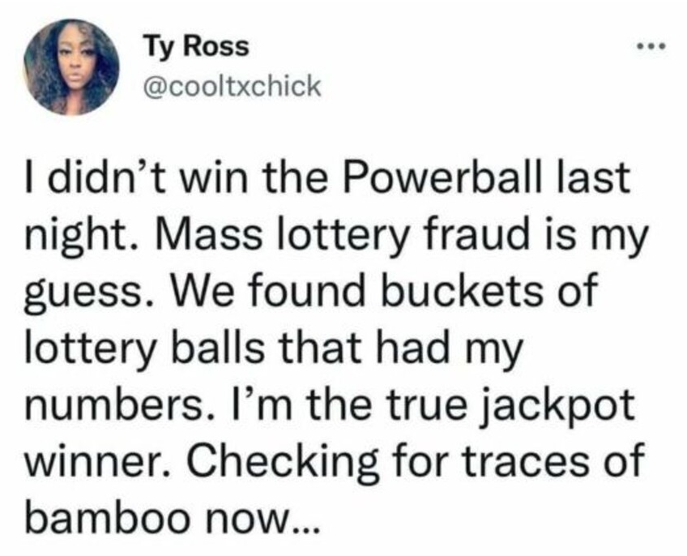
Conclusions
To paraphrase Jeremy Bentham, claims of massive fraud based on aggregate level statistical features of the 2020 election are not just nonsense, but “nonsense on stilts.” (Bentham, 2002)
This essay is deliberately written in a non-technical way to be comprehensible to beginning students in statistics
Although the rebuttal of claims in this essay are focused on those made by Republicans, misuses of statistics is not per se partisan, and one not look hard to find statistical fallacies made by partisans of any stripe

